Slide 1
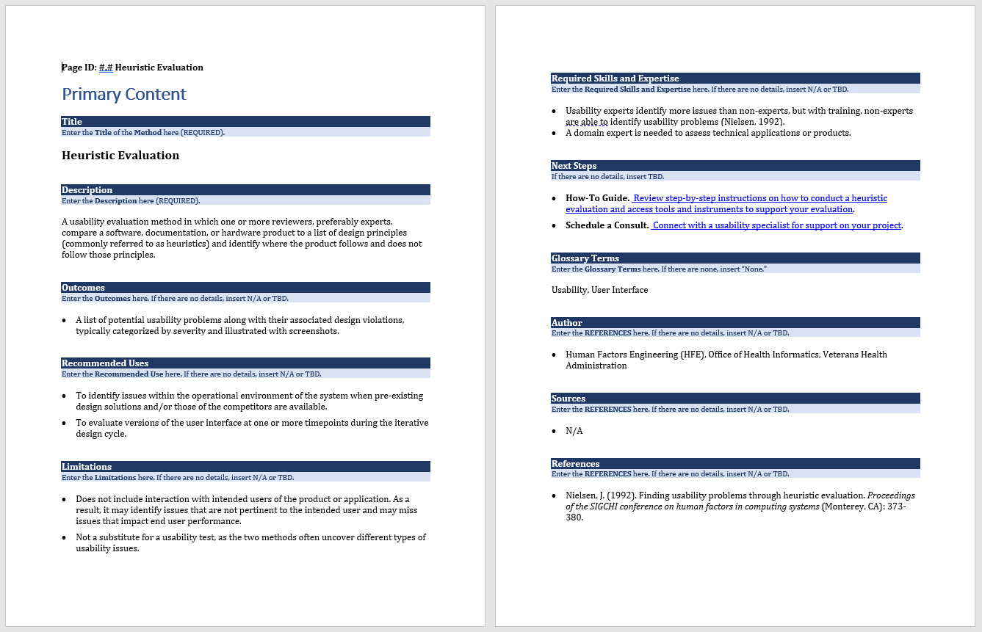
Decision 2020
Method Template & Wires Intersect
What is a Template?
What do we need to decide?
1) What gets a Method page?
2) What’s our strategy for “how-to” content?
Unique page type with its own template OR embedded in the method page?
If latter, does strategy hold when more than one

Slide 2
Methods that employ methods
User Interview
Applied Cognitive Task Analysis
Clinical Workflow Modeling
Ethnographic Study
Gap Analysis
Employed by…
Focus Group
Clinical Workflow Modeling
Root Cause Analysis
Gap Analysis
Observation
Clinical Workflow Modeling
Ethnographic Study
Gap Analysis
User Research
User Testing
User Experience Assessment
Empathy Map
Journey Map
Affinity Diagrams
Fishbone Analysis

Slide 3
Classes of Methods, Techniques, & Activities
EVALUATION METHODS
Cognitive Walkthrough
Heuristic Evaluation
Heuristic Evaluation – Participatory
Screen Consultation
UI Design Audit
Usability Review - Unmoderated
USER TESTING METHODS
Formative Usability Test
Summative Usability Test
Remote testing
A/B
FIELD STUDY METHODS
Ethnography
Contextual Inquiry
Observation
Variants:
KLM (GOMS)
Pluralistic Usability Walkthrough (Usability Walkthrough)
User Interview & Stakeholder Interview
technique: a way of carrying out a particular task
Empathy Map
Journey Map
Affinity Diagrams
Fishbone Analysis
activity: an organizational unit for performing a specific function

Slide 4
Decision 2020
1) What gets a Method page?
Insert text
2) What’s our strategy for “how-to” content?
Unique page type with its own template OR embedded in the method page?
Insert text
If latter, does strategy hold when more than one
Insert text

